Slide 1

JavaScript Basics

Slide 2
JavaScript
For JavaScript, you should know the basic language i.e., HTML and CSS.
JavaScript is the programming language of HTML and the web. It makes web page dynamic. It is interpretated programming language with object oriented capabilities.

Slide 3
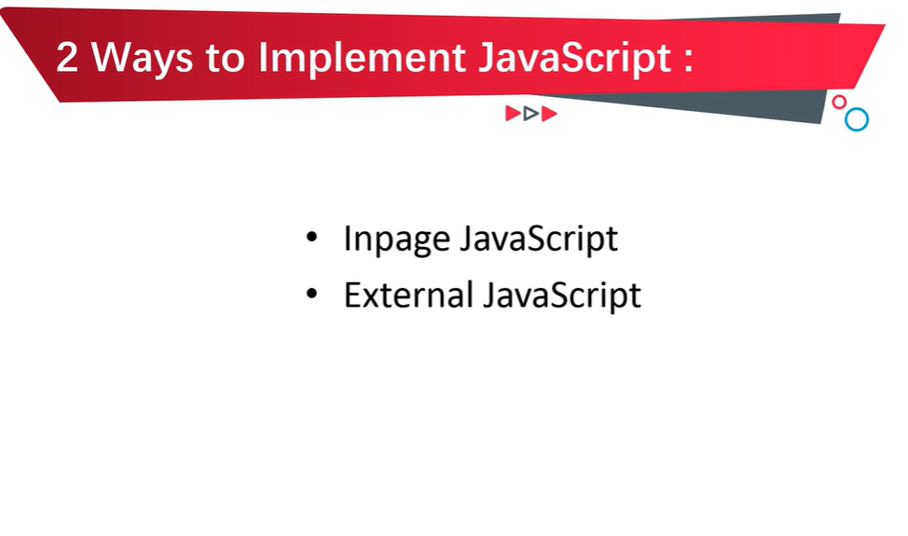

Slide 4
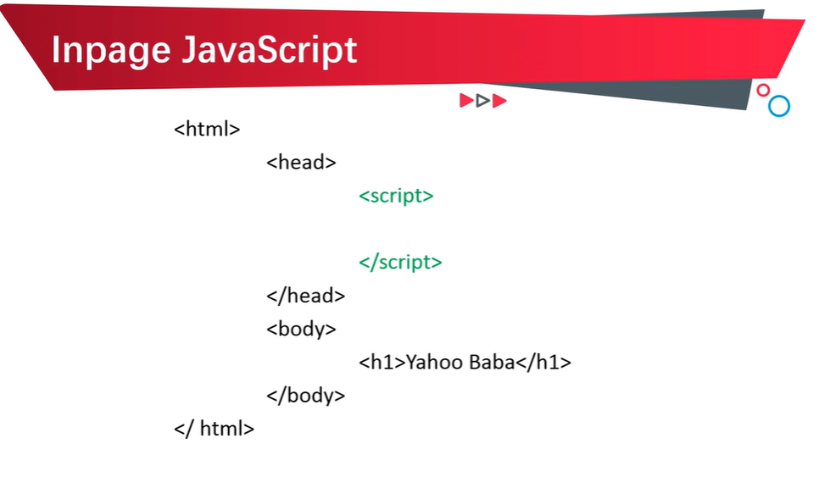

Slide 5
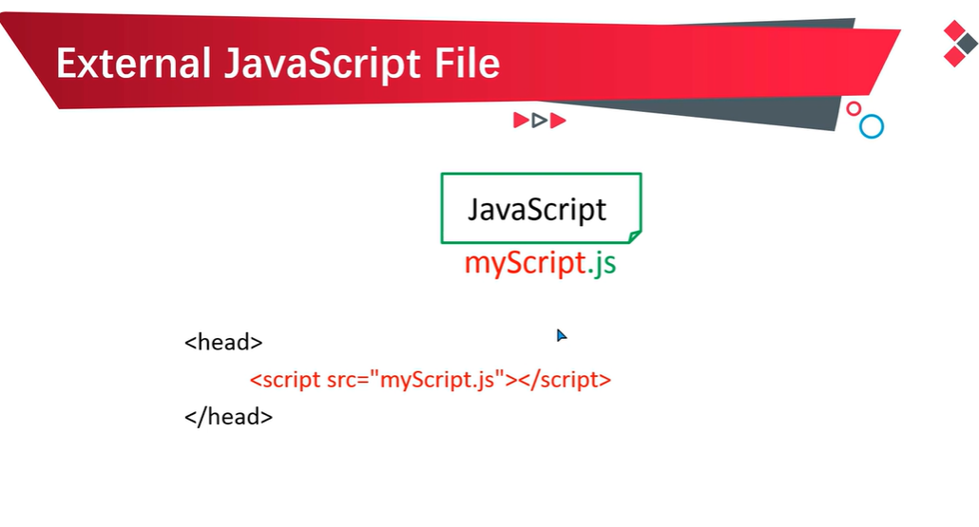

Slide 6
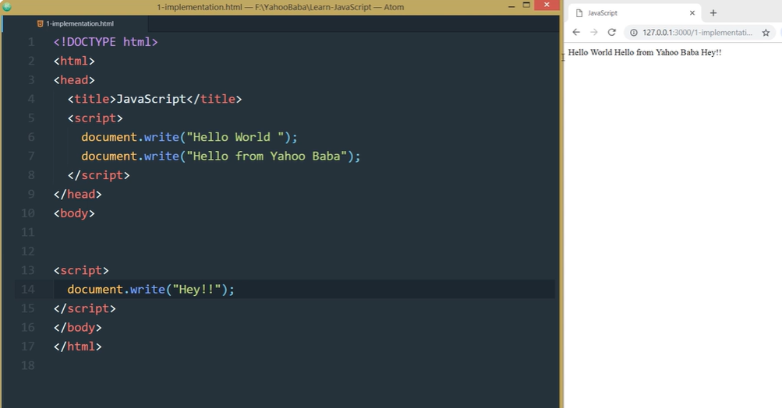
INPAGE JS

Slide 7
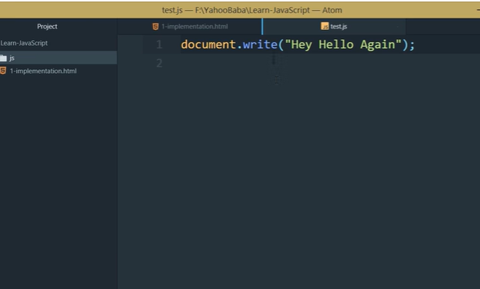
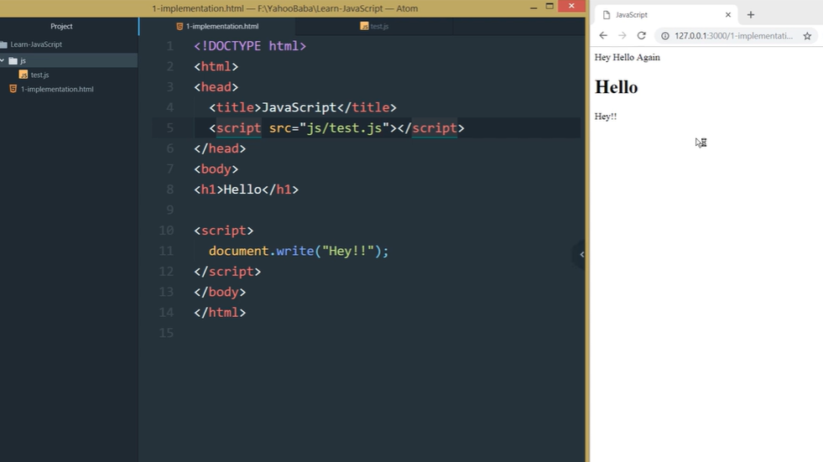
External JS
test.js

Slide 8
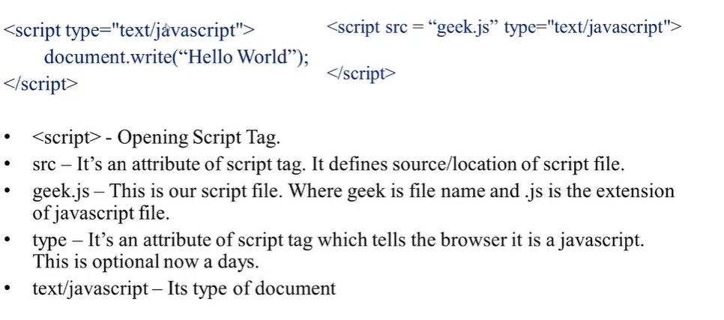
Basic Structure
Document.write() function is used to display the data on the webpage.

Slide 9
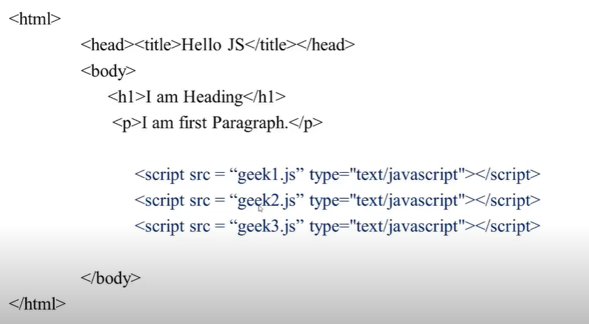
Linking more than one javascript file.

Slide 10
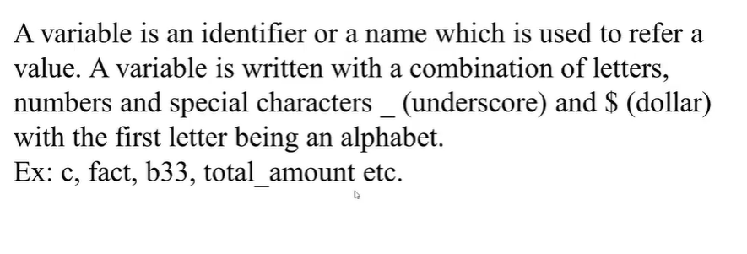
Variable

Slide 11
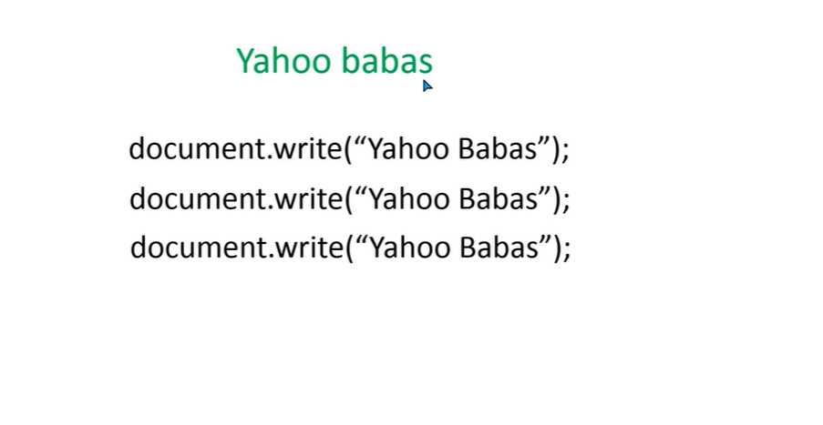
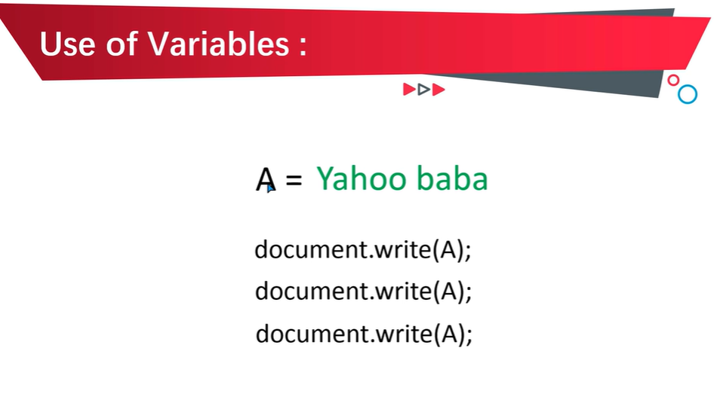

Slide 12
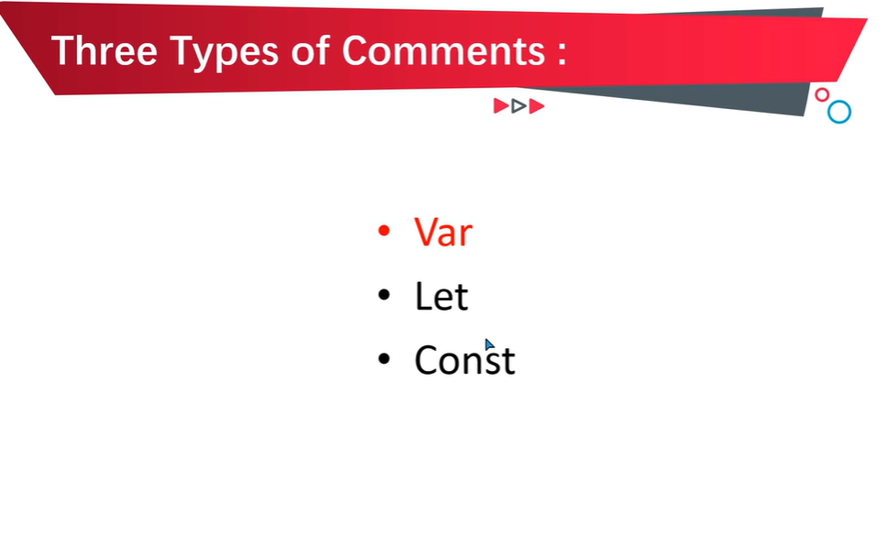

Slide 13
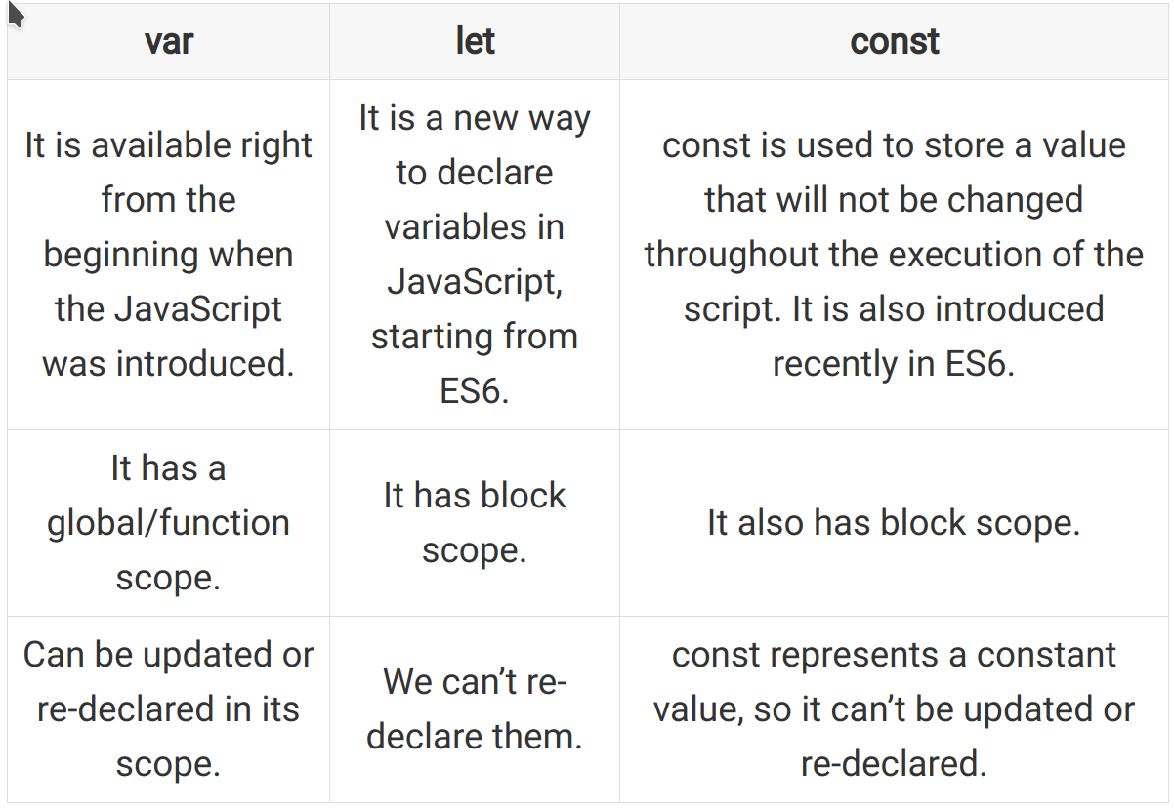

Slide 14
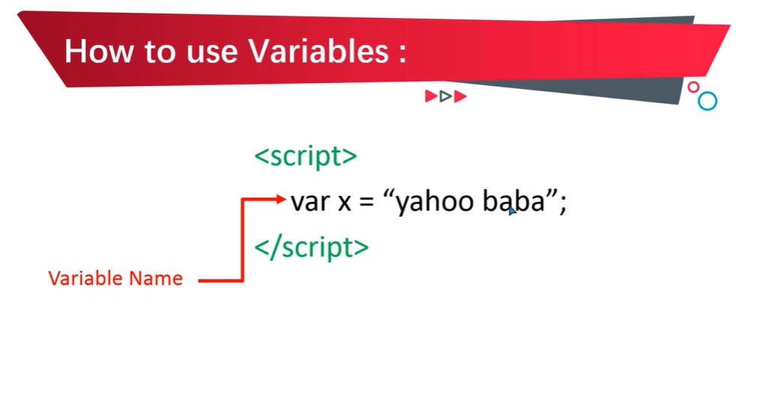

Slide 15
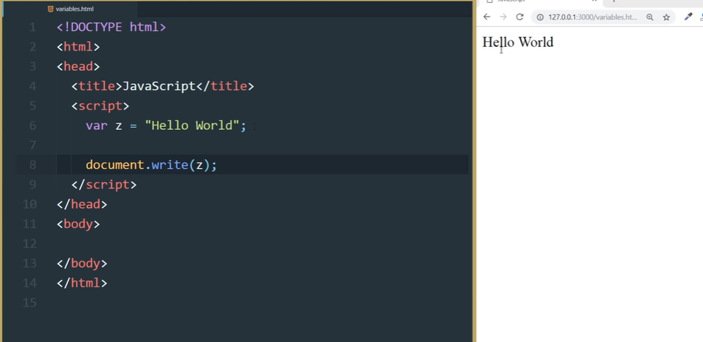

Slide 16
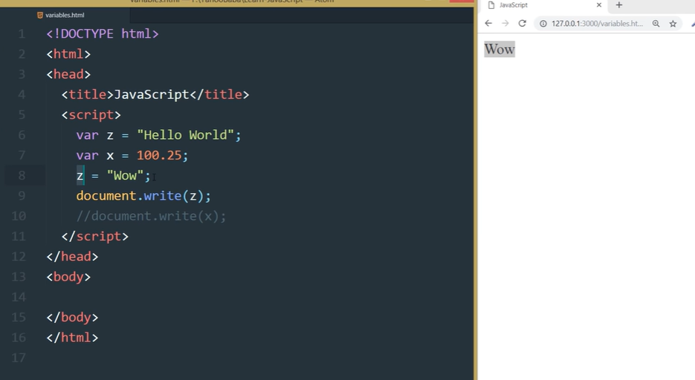

Slide 17
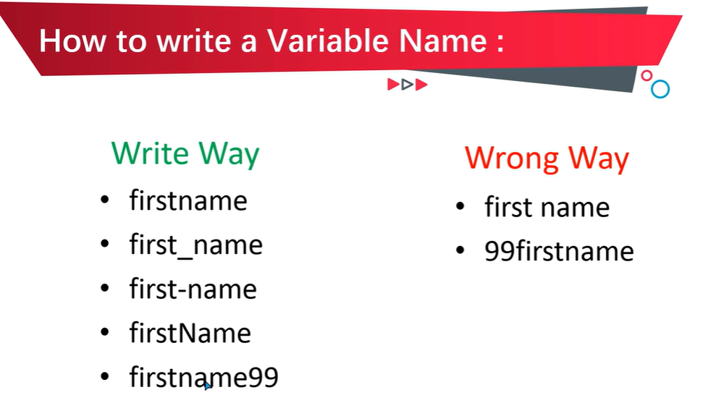

Slide 18
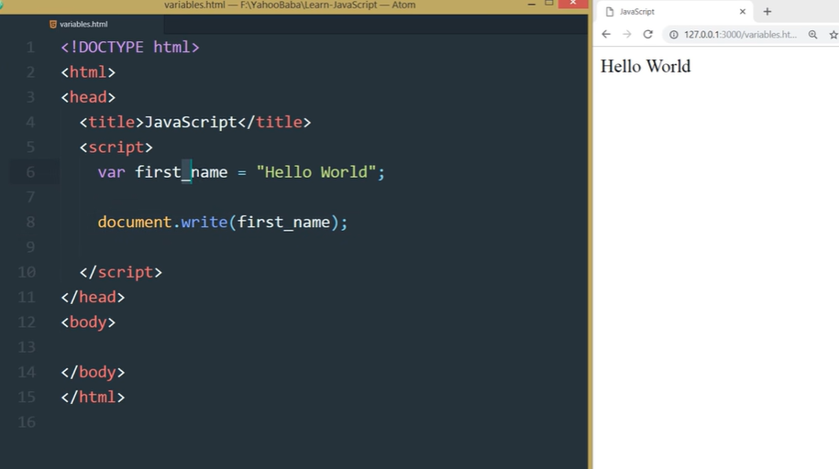

Slide 19
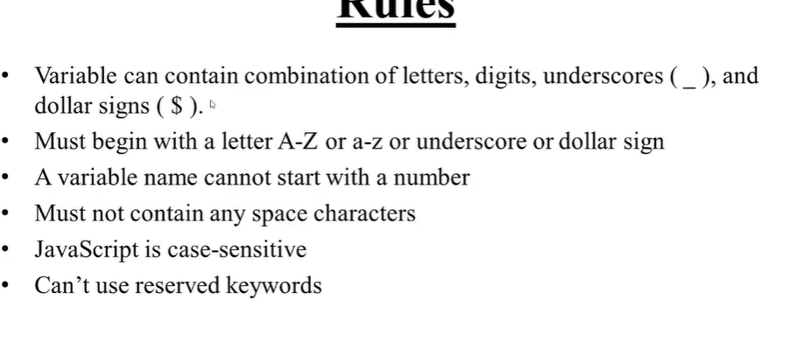
Rules for defining the variables-

Slide 20
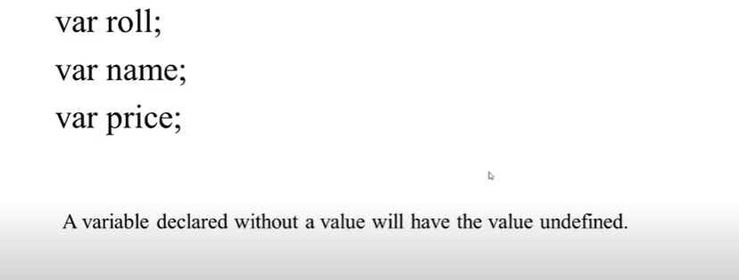
Declaring variable

Slide 21
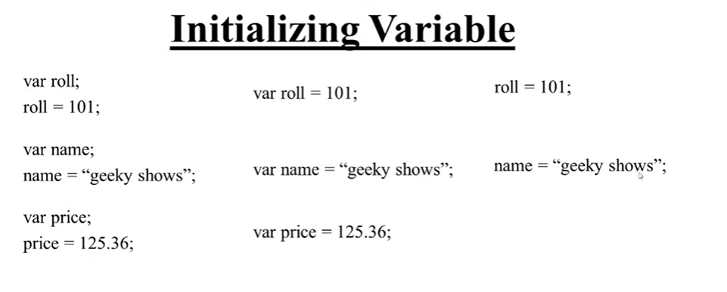
Direct variable initialisation
Good Practice is to write the var datatype for each variable

Slide 22
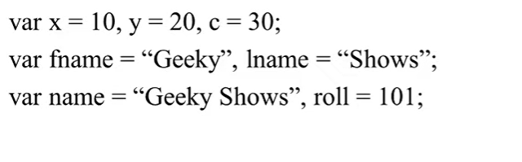
Multiple initialisation of a variable.

Slide 23
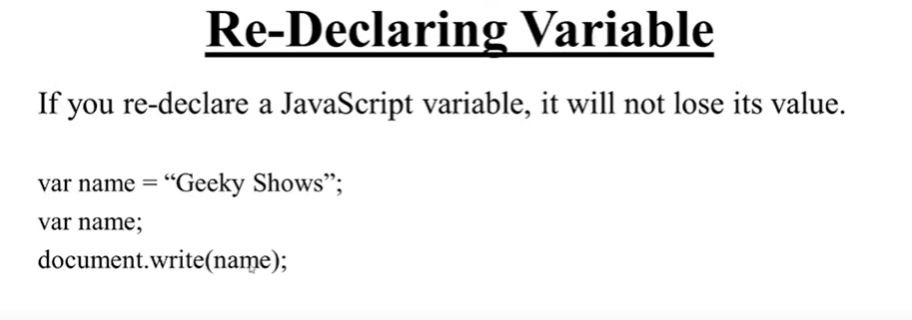

Slide 24
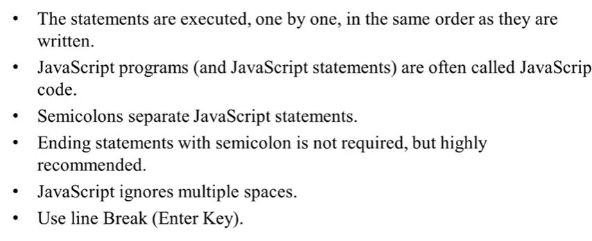

Slide 25
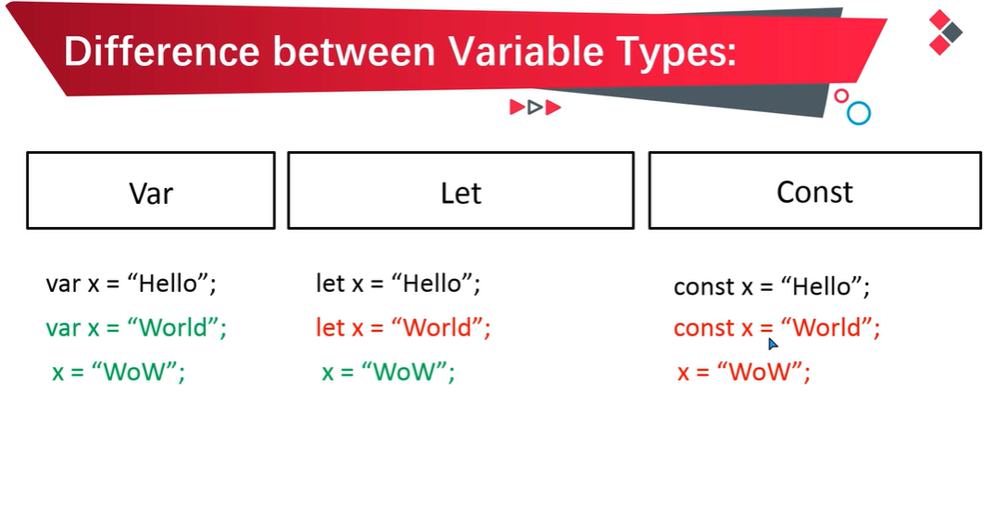

Slide 26
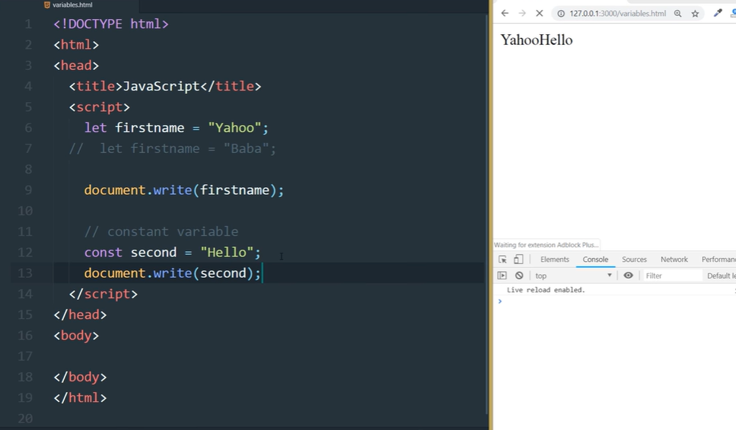
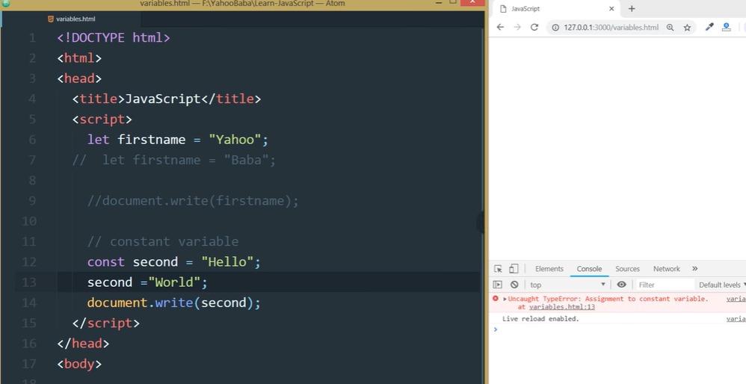

Slide 27
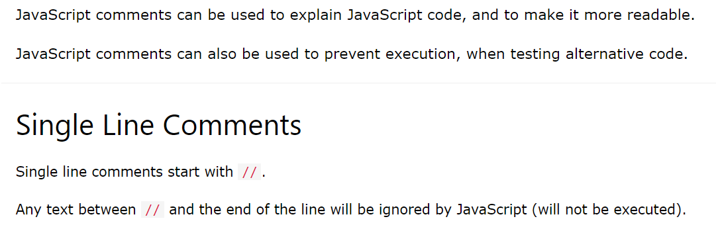
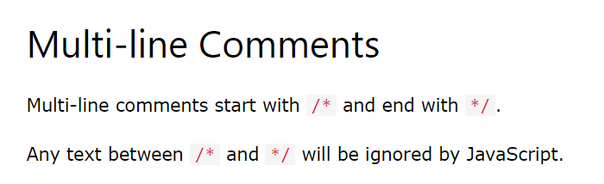
Javascript Comments

Slide 28
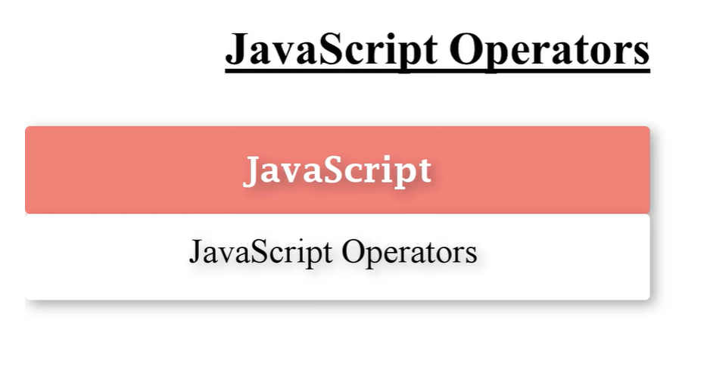

Slide 29
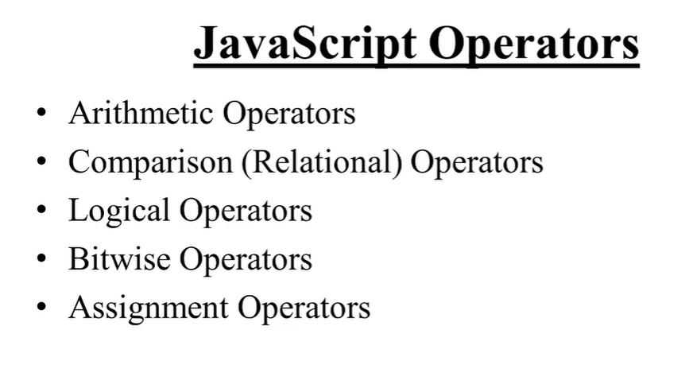

Slide 30
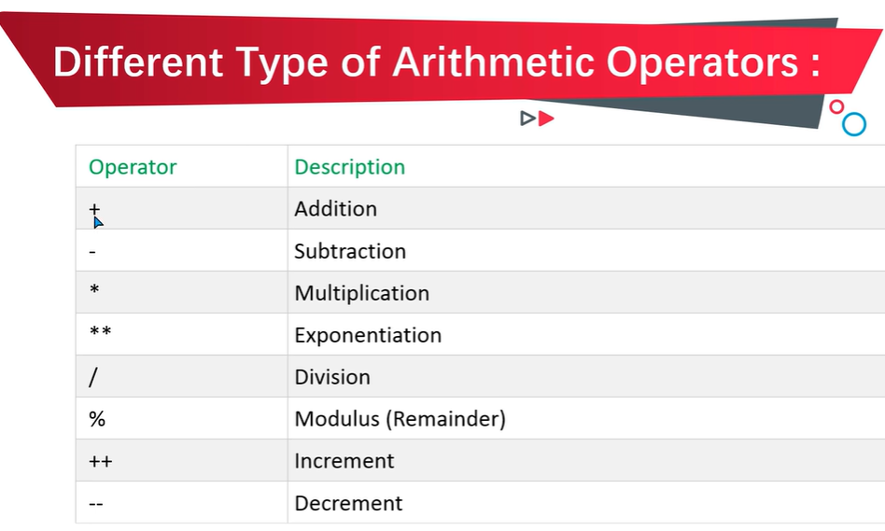
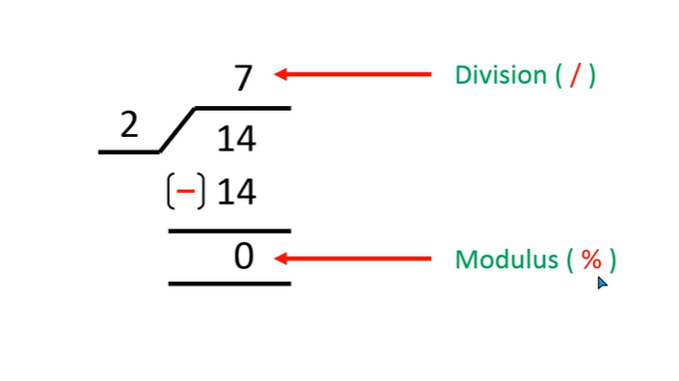

Slide 31
<!DOCTYPE html>
<html>
<body>
<h1>JavaScript Arithmetic</h1>
<h2>The ++ Operator</h2>
<script>
let x = 20;
let y = 10;
let sum = x+y;
let sub = x-y;
let mul = x*y;
let div = x/y;
let mod = x%y;
let b = 2
let exp = b**b;
x++
let z = x;
y--
let a = y;
document.write("Addition:" +sum + "<br>");
document.write("Subtration:" +sub + "<br>");
document.write("Multiplication:" +mul + "<br>");
document.write("Division:" +div + "<br>");
document.write("Modulus:" +mod + "<br>");
document.write("Exponent:" +exp + "<br>");
document.write("Increment:" +z + "<br>");
document.write("Decrement:" +a + "<br>");
</script>
</body>
</html>

Slide 32
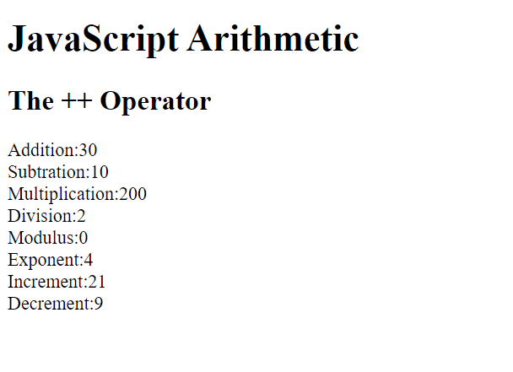

Slide 33
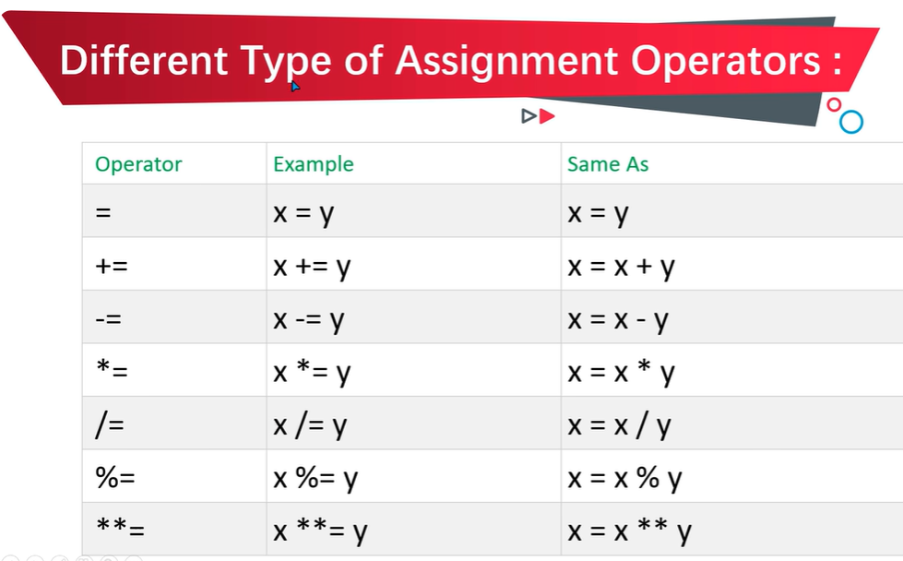

Slide 34
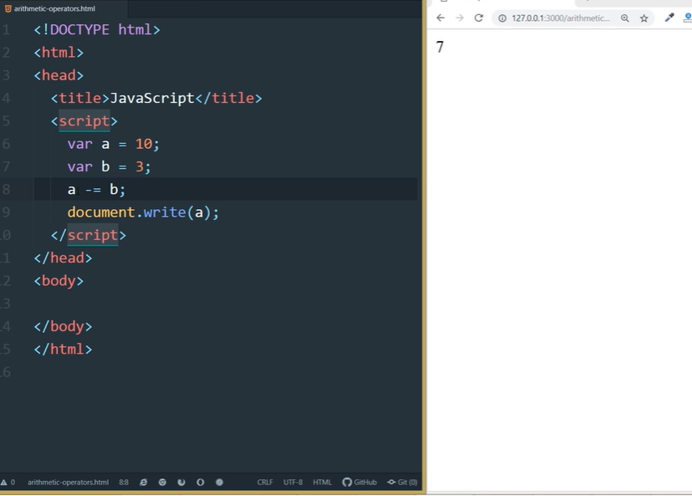
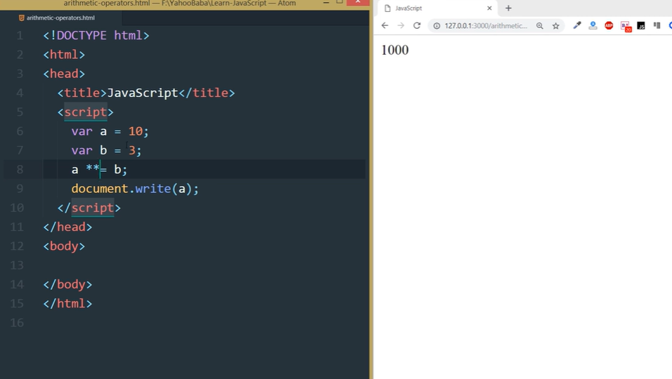

Slide 35
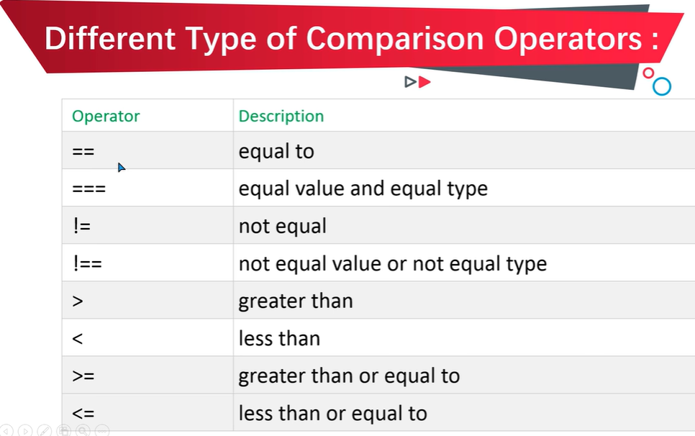

Slide 36
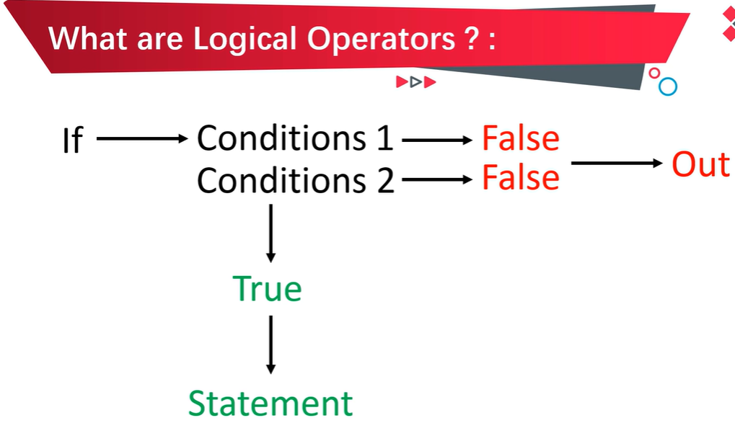

Slide 37
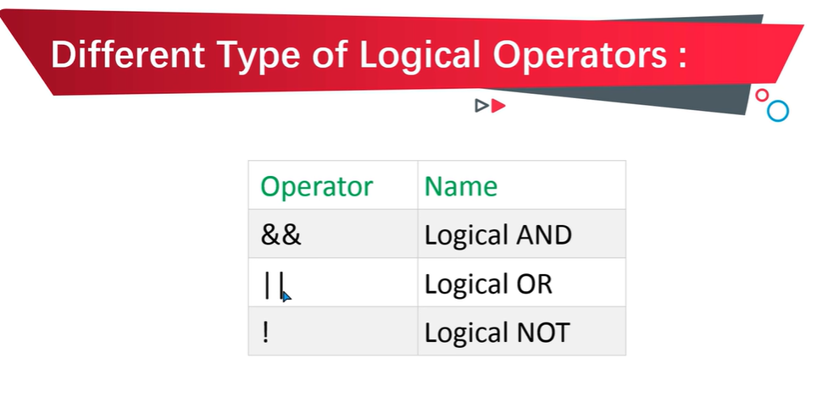

Slide 38
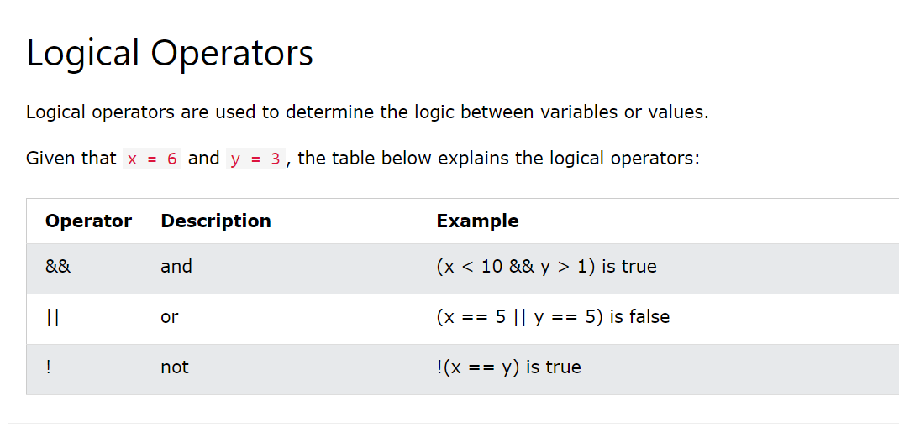

Slide 39
Logical AND Operator
If Condition A and Condition B both are True, then it will Return True.
If Any of the one Condition is False either A or B, then it will return False.
If Both Conditions A and B are False, then it will return False.
Condition A | Condition B | Result
True | True | True
True | False | False
False | True | False
False | False | False

Slide 40
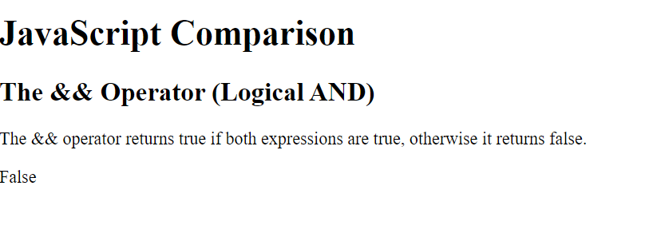
<!DOCTYPE html>
<html>
<body>
<h1>JavaScript Comparison</h1>
<h2>The && Operator (Logical AND)</h2>
<p>The && operator returns true if both expressions are true, otherwise it returns false.</p>
<script>
let a = 10
let b = 20
if(a==10 && b!=20){
document.write("True")
}
else{
document.write("False")
}
</script>
</body>
</html>
Logical AND Operator

Slide 41
Logical OR Operator
If Condition A and Condition B both are True, then it will Return True.
If Any of the one Condition is False either A or B, then it will return True.
If Both Conditions A and B are False, then it will return False.
Condition A | Condition B | Result
True | True | True
True | False | True
False | True | True
False | False | False

Slide 42
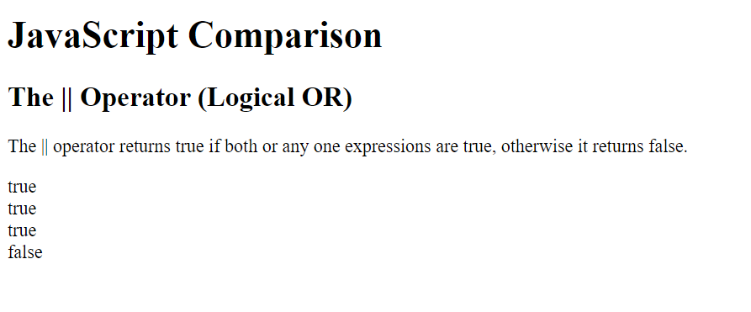
<!DOCTYPE html>
<html>
<body>
<h1>JavaScript Comparison</h1>
<h2>The || Operator (Logical OR)</h2>
<p>The || operator returns true if both or any one expressions are true, otherwise it returns false.</p>
<script>
let a = 10
let b = 20
document.write(a == 10 || b == 20, "<br>")
document.write(a < 10 || b == 20 , "<br>")
document.write(a != 10 || b == 20 , "<br>")
document.write(a != 10 || b != 20)
</script>
</body>
</html>

Slide 43
Logical NOT Operator
If Statement is True then Logical NOT (!) Operator returns False.
If Statement is False then Logical Not(!) Operator returns True.
Statement | Result
True | False
False | True

Slide 44
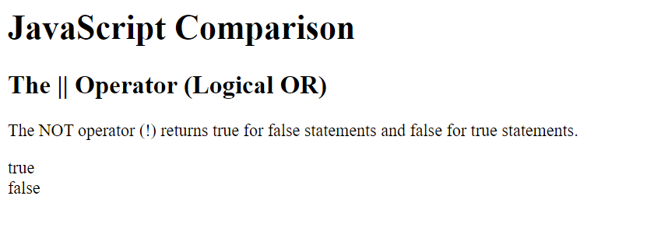
<!DOCTYPE html>
<html>
<body>
<h1>JavaScript Comparison</h1>
<h2>The || Operator (Logical OR)</h2>
<p>The NOT operator (!) returns true for false statements and false for true statements.</p>
<script>
let a = 10
let b = 20
document.write(! (a == b), "<br>")
document.write(! (a != b))
</script>
</body>
</html>

Slide 45
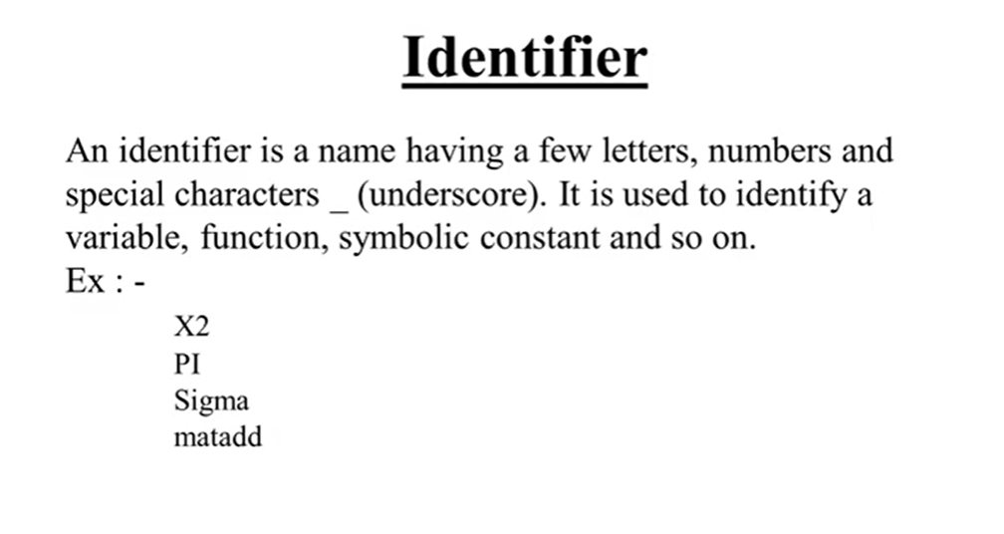

Slide 46
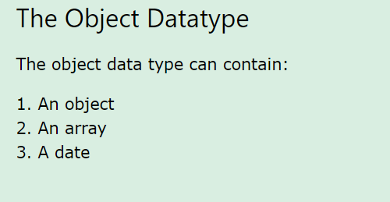
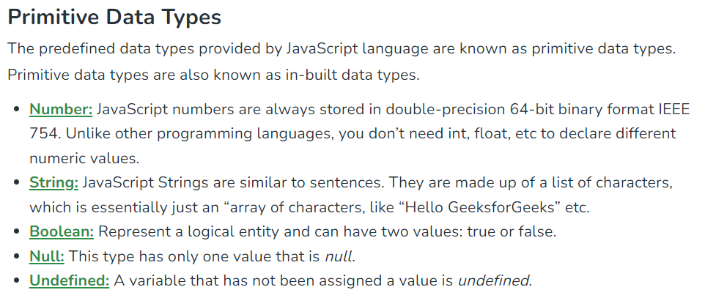
Datatypes
Non Primitive type

Slide 47
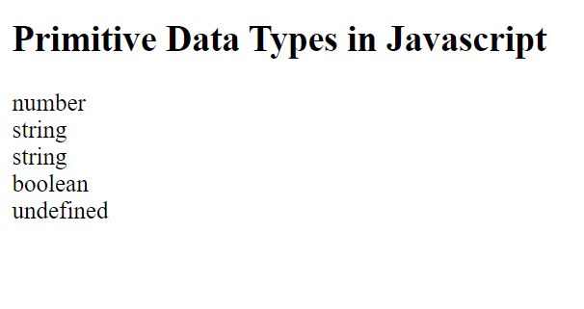
<!DOCTYPE html>
<html>
<body>
<h2>Primitive Data Types in Javascript</h2>
<script>
let a = 10; //Number Type
let name = "John"; //String Type
let Name = 'John'; //String Type
let isAge = true; //Boolean Type
let c; //Undefined Type
document.write(typeof a + "<br>");
document.write(typeof name + "<br>");
document.write(typeof Name + "<br>");
document.write(typeof isAge + "<br>");
document.write(typeof c);
</script>
</body>
</html>

Slide 48
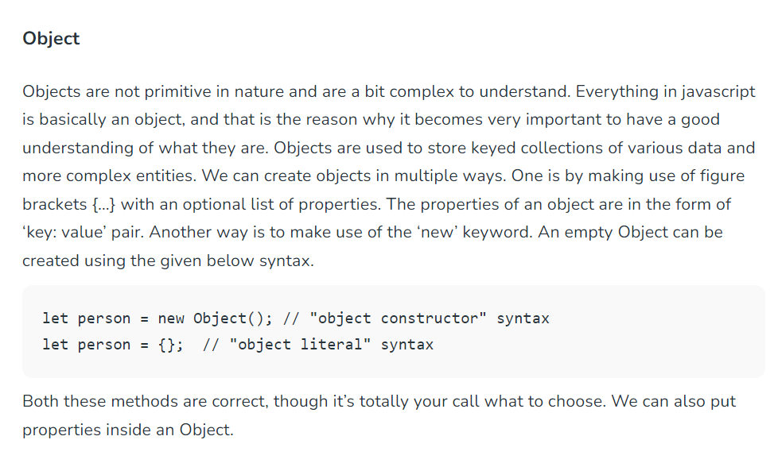

Slide 49
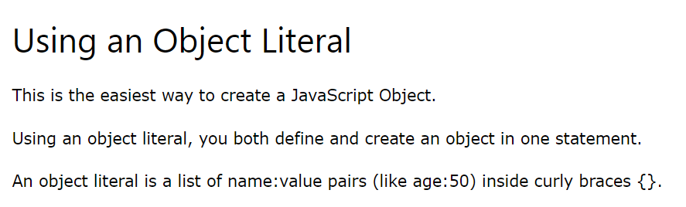

Slide 50


<!DOCTYPE html>
<html>
<body>
<h2>JavaScript Objects</h2>
<p>Creating a JavaScript Object:</p>
<script>
const person = new Object();
person.firstName = "John";
person.lastName = "Doe";
person.age = 50;
person.eyeColor = "blue";
document.write(person.firstName + " " + person.lastName);
</script>
</body>
</html>

Slide 51

<!DOCTYPE html>
<html>
<body>
<h2>JavaScript Objects</h2>
<p>Creating an object:</p>
<script>
const person = {
firstName : "John",
lastName : "Doe",
age : 50,
eyeColor : "blue"
};
document.write(person.firstName +" " + person.lastName);
</script>
</body>
</html>

Slide 52


Slide 53


Slide 54



Slide 55

Function Return

Slide 56
Control Statements
JavaScript control statement is used to control the execution of a program based on a specific condition. If the condition meets then a particular block of action will be executed otherwise it will execute another block of action that satisfies that particular condition.
Types of Control Statements in JavaScript
Conditional Statement: These statements are used for decision-making, a decision is made by the conditional statement based on an expression that is passed. Either YES or NO.
Iterative Statement: This is a statement that iterates repeatedly until a condition is met. Simply said, if we have an expression, the statement will keep repeating itself until and unless it is satisfied.

Slide 57
There are several methods that can be used to perform control statements in JavaScript.
If Statement
Using If-Else Statement
Using If Else-if else Statement
Using Switch Statement

Slide 58
If Statement
Syntax:
if ( condition_is_given_here ) { // If the condition is met, //the code will get executed. }

Slide 59

const num = 5;
if (num > 0) {
console.log("The number is positive.");
};

Slide 60

If else Statement
The if-else statement will perform some action for a specific condition. If the condition meets then a particular code of action will be executed otherwise it will execute another code of action that satisfies that particular condition.

Slide 61

let num = -10;
if (num > 0)
console.log("The number is positive.");
else
console.log("The number is negative");

Slide 62


Slide 63

const num = 5;
if (num > 0) {
console.log("The number is positive.");
}
else if (num == 0){
console.log("The number is positive.");
}
else{
console.log("The number is negative.");
};

Slide 64

Switch Statement
The switch case statement in JavaScript is also used for decision-making purposes. In some cases, using the switch case statement is seen to be more convenient than if-else statements.

Slide 65

let num = 5;
switch (num) {
case 0:
console.log("Number is zero.");
break;
case 1:
console.log("Number is one.");
break;
case 2:
console.log("Number is two.");
break;
default:
console.log("Number is greater than 2.");
};

Slide 66


Slide 67

<script>
let day = 3;
let dayName;
switch (day) {
case 1:
dayName = 'Sunday';
break;
case 2:
dayName = 'Monday';
break;
case 3:
dayName = 'Tuesday';
break;
case 4:
dayName = 'Wednesday';
break;
case 5:
dayName = 'Thursday';
break;
case 6:
dayName = 'Friday';
break;
case 7:
dayName = 'Saturday';
break;
default:
dayName = 'Invalid day';
}
document.write("The day is" + " " + dayName);
</script>

Slide 68
Javascript Loops
The JavaScript loops are used to iterate the piece of code using for, while, do while or for-in loops. It makes the code compact. It is mostly used in array.
There are four types of loops in JavaScript.
for loop
while loop
do-while loop

Slide 69

LOOPS in JAVASCRIPT

Slide 70


Slide 71

While Loop
The JavaScript while loop iterates the elements for the infinite number of times. It should be used if number of iteration is not known. The syntax of while loop is given below.
<script>
var i=11;
while (i<=15)
{
document.write(i + "<br/>");
i++;
}
</script>

Slide 72

Do-while Loop
The JavaScript do while loop iterates the elements for the infinite number of times like while loop. But, code is executed at least once whether condition is true or false. The syntax of do while loop is given below.
<script>
var i=21;
do{
document.write(i + "<br/>");
i++;
}while (i<=25);
</script>

Slide 73

For Loop
The JavaScript for loop iterates the elements for the fixed number of times. It should be used if number of iteration is known. The syntax of for loop is given below.
<script>
for (i=1; i<=5; i++)
{
document.write(i + "<br/>")
}
</script>

Slide 74

ARRAYS in JAVASCRIPT

Slide 75


Slide 76



Slide 77

ARRAYS METHODS
The slice() method returns selected elements in an array, as a new array.

Slide 78



Slide 79

The splice() method is used to add or remove elements of an existing array and the return value will be the removed items from the array.

Slide 80


Slide 81

Array Methods
https://www.w3schools.com/js/js_array_methods.asp

Slide 82


Slide 83


Slide 84


Slide 85


Slide 86


Slide 87


Slide 88


Slide 89


Slide 90


Slide 91


Slide 92


Slide 93


Slide 94


Slide 95


Slide 96


Slide 97


